Slide 1

Habit Manager Frontend
A React-powered interface for creating habits, tracking daily progress, and visualizing personal growth through score updates.
Mohamed Askar S (23SUCA08)

Slide 2
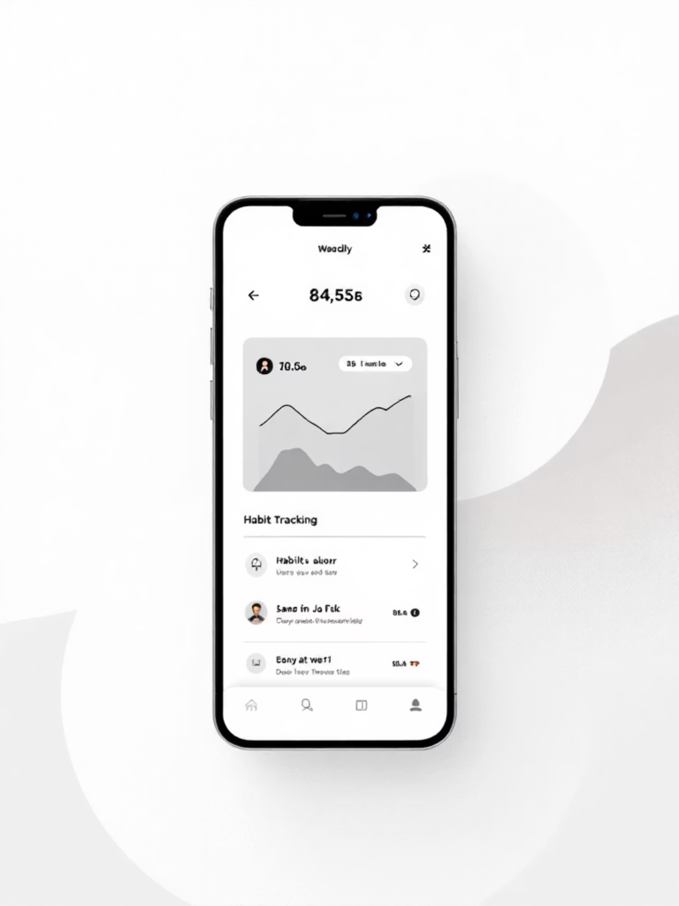
Project Overview
What It Does
This React frontend connects to a backend API to manage user habits, track completion status, and update scoring systems in real-time.
Core Features
Create and manage custom habits
Track daily progress with simple clicks
Update scores based on habit completion
View all users and their habit data

Slide 3


Live Demo & Access
Production URL
Deployed on Vercel at habit-frontend-alpha.vercel.app
Source Code
Available on GitHub for review and contribution

Slide 4


Important: Backend Dependency
⚠️ Critical Setup Step
This frontend requires the backend service to be running before data loads. Render's free plan takes 30-60 seconds to spin up.
Launch Frontend
Wait for Startup
Open the Vercel URL. Data should now load successfully
Open Backend First
Allow 30-60 seconds for Render to activate the server (free tier sleep mode)
Visit https://habit-backend-7mh4.onrender.com/api/users/all in your browser

Slide 5

Technology Stack
React
Component-based UI architecture with modern hooks and state management
Axios
HTTP client for seamless API communication with the backend service
HTML/CSS/JS
Modern web standards with semantic markup and responsive styling
Vercel
SonarCloud
Production-grade deployment with automatic CI/CD and CDN
Code quality analysis with passing Quality Gate

Slide 6

Running Locally
01
Clone Repository
git clone https://github.com/<your-username>/habit-frontend.git
02
Navigate to Project
cd habit-frontend
03
Install Dependencies
npm install
04
Start Development Server
npm start
Application runs at http://localhost:3000 with hot reloading enabled.

Slide 7
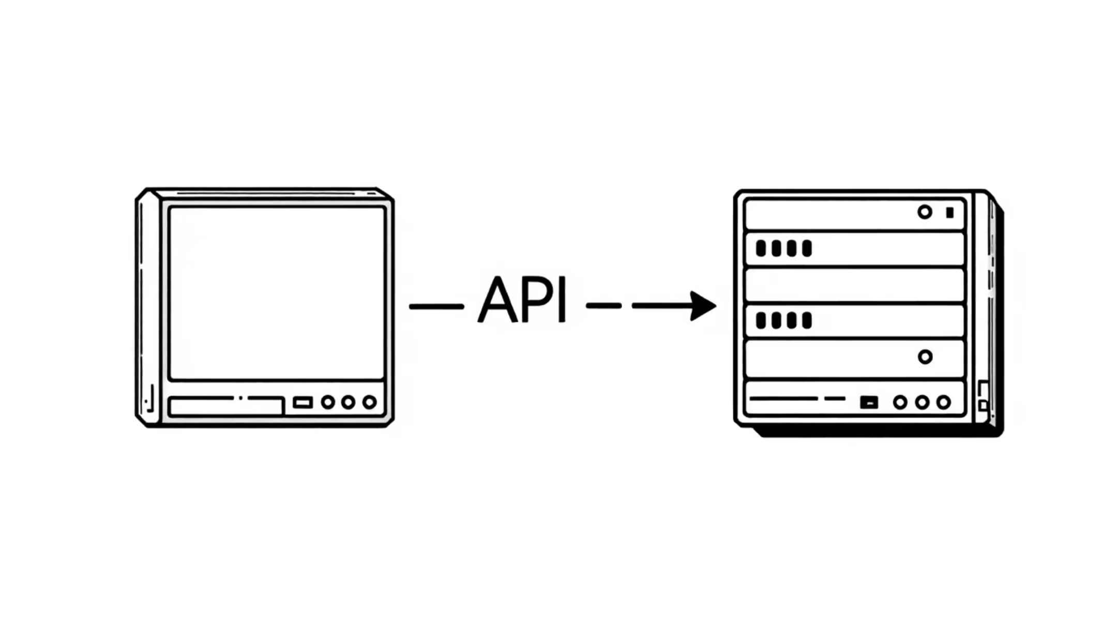
Backend Integration
Repository
Find the backend codebase at github.com/<your-username>/habit-backend
API Endpoint
Main data endpoint: https://habit-backend-7mh4.onrender.com/api/users/all
Communication
Frontend uses Axios to send GET and POST requests for user data and habit updates

Slide 8
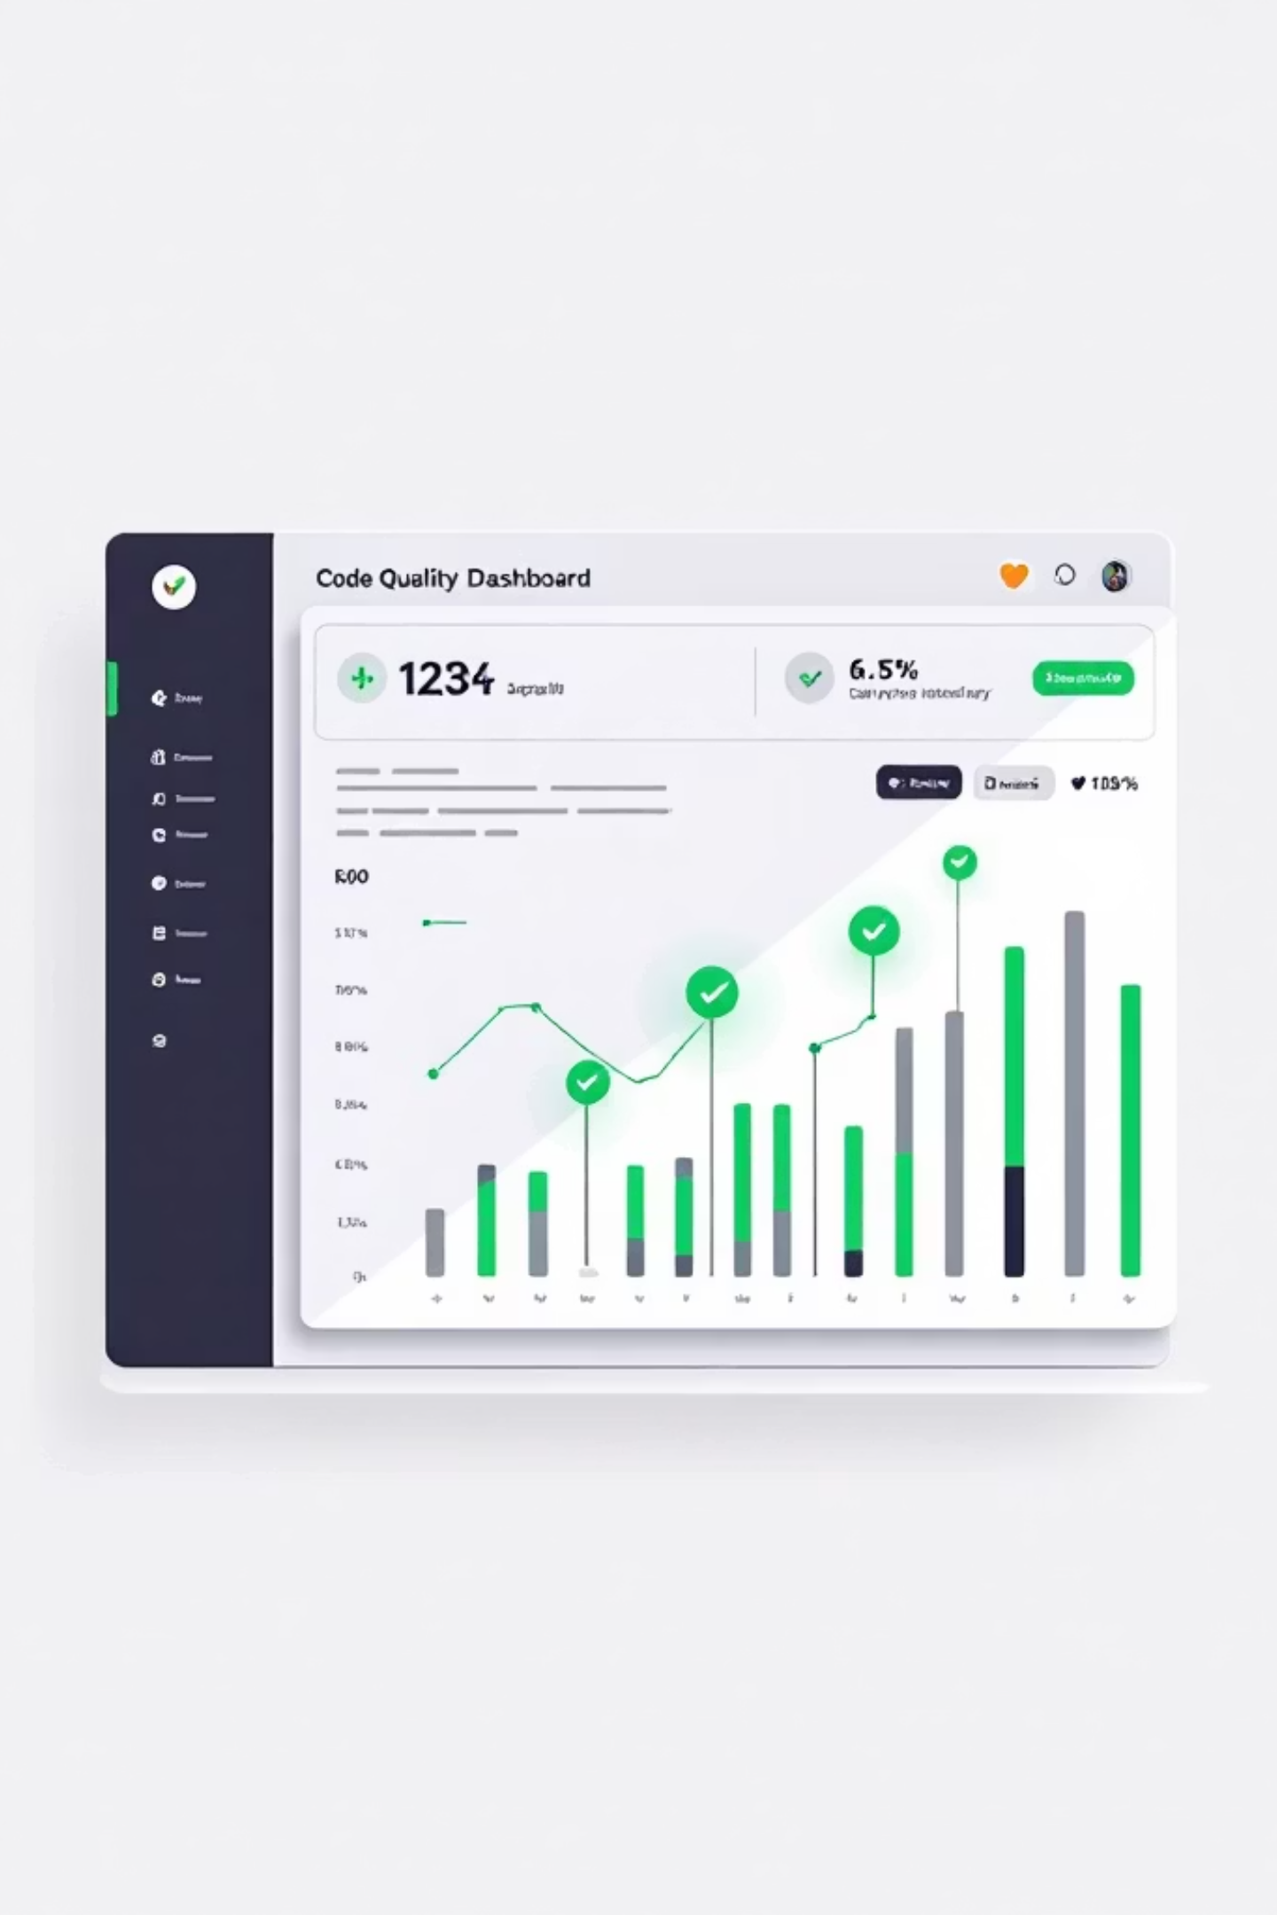
Quality Assurance
SonarCloud Integration
Automated code analysis configured to run on every commit, ensuring consistent code quality standards across the codebase.
Quality Gate ✅
Project passes all quality checks including bug detection, code smells, security vulnerabilities, and test coverage metrics.
Best Practices
Enforces consistent coding standards, proper documentation, and maintainable component architecture throughout the application.

Slide 9

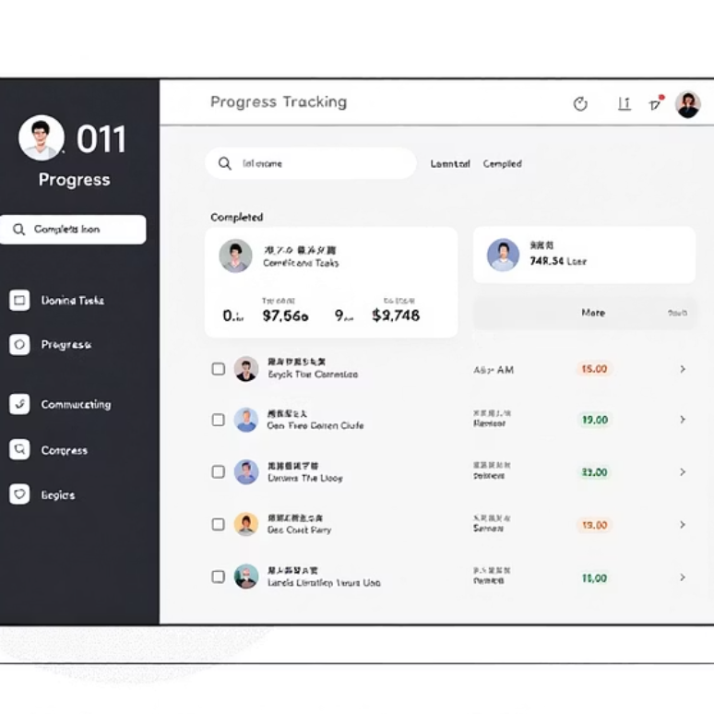

Key Features
Habit Creation
Progress Tracking
Score Updates
Users can define new habits with custom names, frequencies, and tracking parameters
Simple click interface marks habits as complete, updating streaks and scores automatically
Dynamic scoring system reflects completion patterns and consistency over time

Slide 10

Project Resources
Frontend Repository
Backend Repository
Source code, documentation, and contribution guidelines available on GitHub
Complete API documentation and database schema details for integration
Project Presentation
Download comprehensive PPT for stakeholder review and project evaluation

